Slide 1

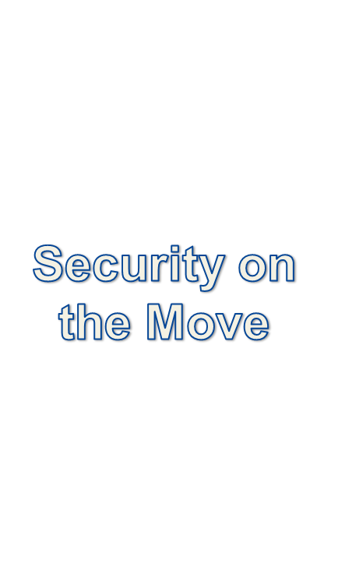

Slide 2

Identify risks with mobile devices:
Portable data storage
Wireless connections
3rd party applications
Data integrity
Data availability

Slide 3

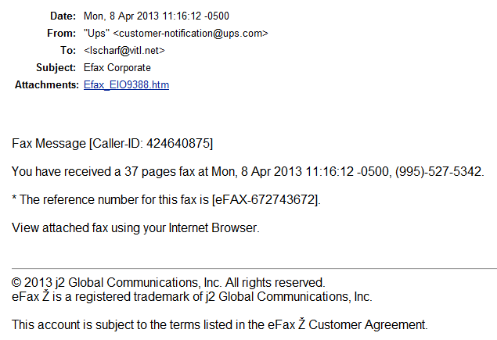

Slide 4

Mobile device:
  Electronic computing or storage device
  Smart phone
  USB drive
  Tablet
  CD, DVD
PHI: Protected Health Information

Slide 5

Mobile devices are necessary in health care
PHI will migrate to mobile devices
Mobile technology will evolve
Devices will be stolen or lost
Notes:
Therefore, you must have a security strategy that is complete and able to encompass technology changes.

Slide 6

Types of connections:
Cellular
WIFI
Bluetooth
Radio (RFID)
With more to come…
  TransferJet

Slide 7
The risks:
  Device is hacked
  User sends data to wrong destination
The solutions:
  Trusted connections only
  Secure connections
    SSL for web traffic
    WPA2 for WIFI
  Data encryption

Slide 8

The risks:
  Device is lost or stolen
  Device is hacked
The solutions:
  Encryption, encryption, encryption!
  Minimum necessary
  Remote wipe capability
  Password policy

Slide 9

The risks:
  Device is hacked
  Device is rendered inoperable/unreliable
The solutions:
  Trusted applications only
  Minimum necessary
  Security application (scans for malware)
Notes:
Organization can also use a management product with its own “app store”

Slide 10

The risks:
  Device is unavailable
  App compromises data
The solutions:
  Secure connections, anti-malware, trusted applications
  Update the OS and apps

Slide 11

The risks:
  Device is hacked
  App compromises data
The solutions:
  Secure connections, anti-malware, trusted applications, update the OS and apps
  Reset the OS (locally or remotely)

Slide 12

Minimum Necessary Data
Secure Connection
Password Policy
Malware Protection
Data Encryption
Trusted Applications
OS Management
Remote Wipe
Can be managed with software

Slide 13

Identify the benefits of mobility
Quantify the risks
Weigh the risks and benefits
Find a solution that mitigates the risks
Write your operator’s manual
  Policies and procedures
Keep track of things
Keep your staff educated

Slide 14

HIPAA compliance is possible if you have a plan
Achieve the right balance of technology and security

Slide 15
QUESTIONS?
Lauri Scharf
lscharf@vitl.net

